Slide 1

DEPARTMENT OF COMPUTER SCIENCE AND ENGINEERING
INTERSHIP REVIEW-1 PRESENTATION
“PLATTED HEAT EXCHANGER RUNTIME CALCULATOR AND NOTIFIER (PHE)”
Presented By :
DARSHAN K (1DB20CS032)

Slide 2

Robert Bosch or Bosch, is a German multinational engineering and technology company headquartered in Gerlingen, near Stuttgart, Germany. The company was founded by Robert Bosch in Stuttgart in 1886. Bosch is 92% owned by Robert Bosch Stiftung. Bosch's core operating areas are spread across four business sectors; mobility (hardware and software), consumer goods (including household appliances and power tools), industrial technology (including drive and control) and energy and building technology. . BOSCH Group founded in 1886 in Germany as a workshop for precision Mechanics and Electrical engineering by Robert BOSCH Group. The special ownership structure of the Bosch group guarantees its financial independence and entrepreneurial freedom

Slide 3
CONTENTS
Introduction
Problem Statement
Scope & Objectives
Existing System
Proposed Methodology
Outcome(Results)
Conclusion

Slide 4
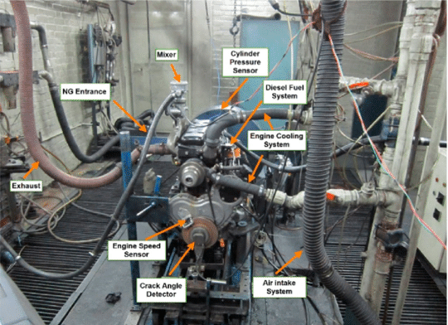
INTRODUCTION
The "Engine Testing Cell Temperature Control System" integrates a Nodemcu ESP8266 and ACS71 Current Sensor for real-time motor feedback, ensuring precise temperature control in testing environments.

Slide 5
PLATTED HEAT EXCHANGERS
Efficient Heat Transfer: Platted heat exchangers achieve superior heat transfer efficiency through their compact design and increased surface area.
Customizable Configuration: The modular design of platted heat exchangers allows for easy customization to meet specific requirements, providing versatility across industries.
Fast Heat Recovery: Platted heat exchangers enable swift heat recovery processes with minimal thermal resistance, making them suitable for applications requiring rapid temperature adjustments.
Compact and Space-Efficient: The closely spaced plates in platted heat exchangers create a compact design, making them space-efficient and suitable for installations with limited space.
Cost-Effective and Durable: Constructed with durable materials like stainless steel, platted heat exchangers offer cost-effective solutions in both initial investment and maintenance, ensuring a longer lifespan and reduced operational costs

Slide 6
PROBLEM STATEMENT
"To build a Run time calculator and notifier regarding the usage of Platted Heat Exchanger in the engine Test cell”
•There should be a platform to access and watchout the RunTime
•Get pre notification of deadline
•Get the alert mail of deadline RunTime

Slide 7
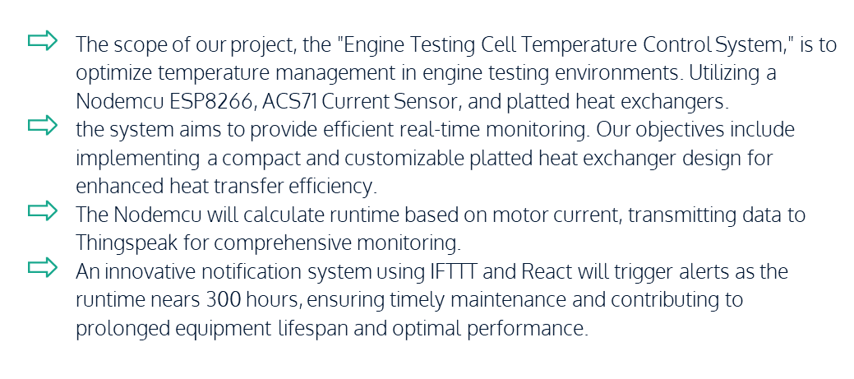
OBJECTIVES

Slide 8
Existing system
In the existing methodology for engine testing cells, runtime calculations heavily rely on manual input from operators.
Human intervention is required to assess the motor's current and estimate the equipment's runtime. This method, while longstanding, is susceptible to inaccuracies due to human error, potentially leading to inefficient testing processes and increased maintenance costs.
Moreover, the lack of real-time monitoring limits the system's ability to promptly detect and address issues. The proposed project aims to replace this manual approach with an automated system, leveraging technology for precise runtime calculations and proactive maintenance in engine testing environments.
8

Slide 9
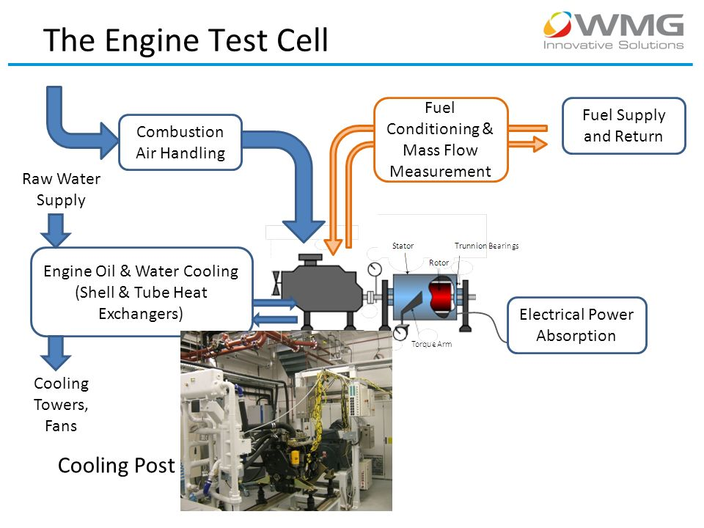
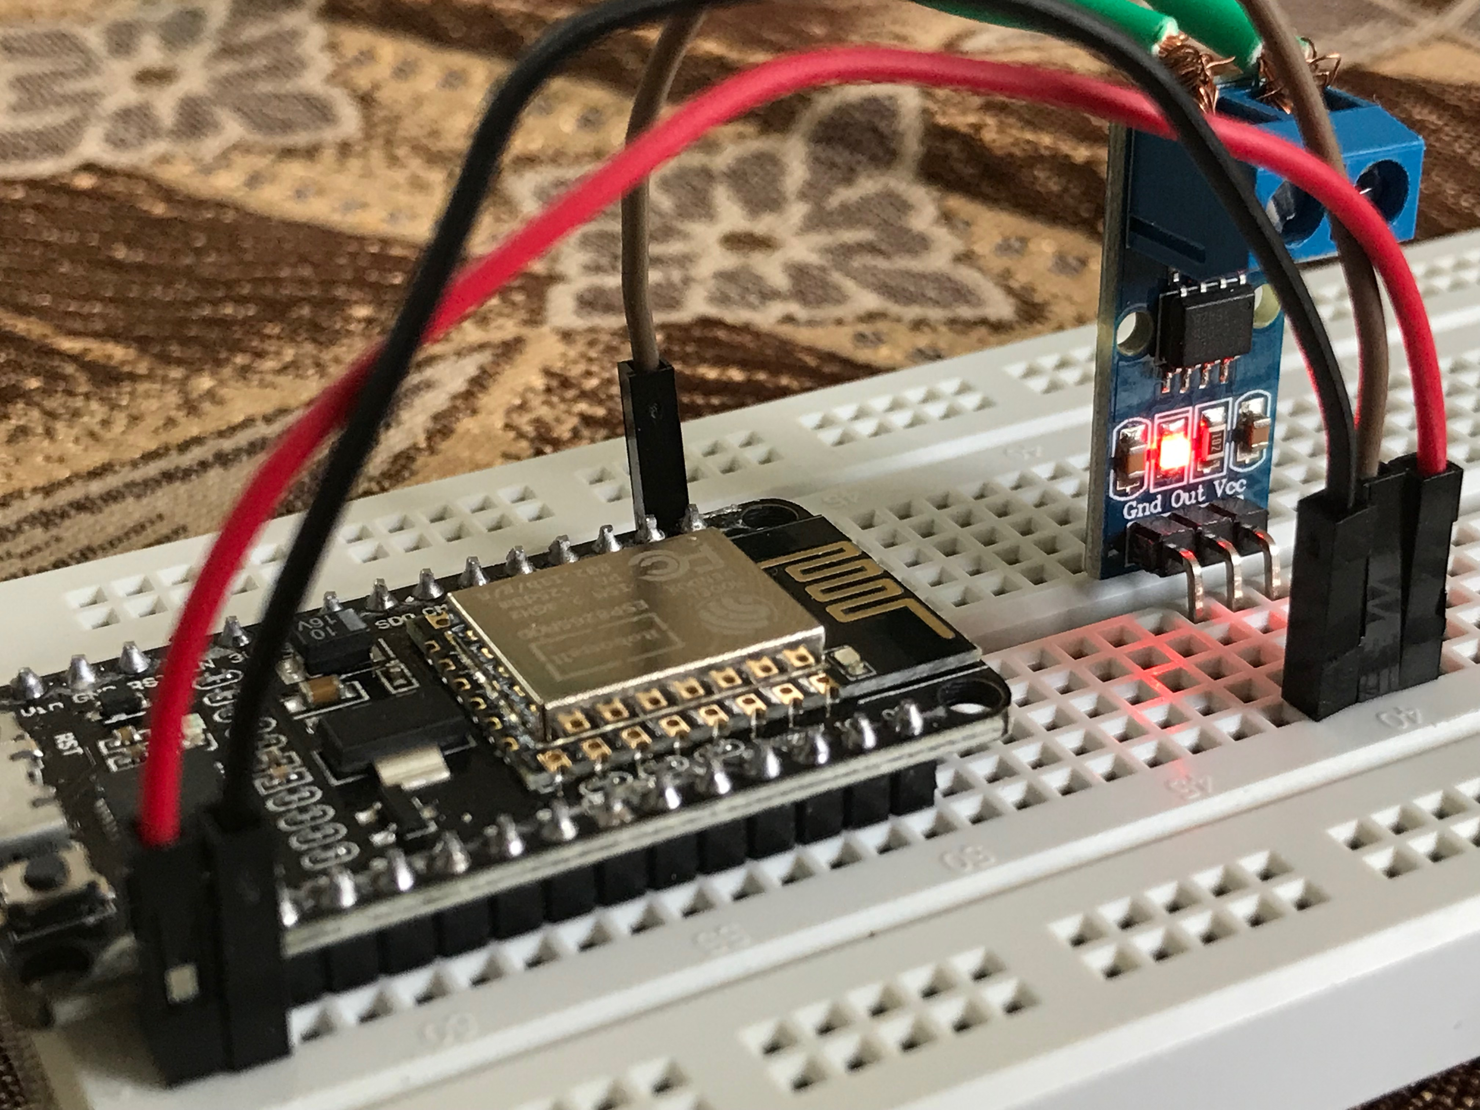
Proposed Methodology
Automated Runtime Calculation: Implement a Nodemcu ESP8266 to automate the calculation of engine runtime based on real-time feedback from the ACS71 Current Sensor.
.
Real-time Monitoring: Utilize the Nodemcu to provide continuous monitoring of motor current, enabling instant updates on the equipment's operational status.
9

Slide 10

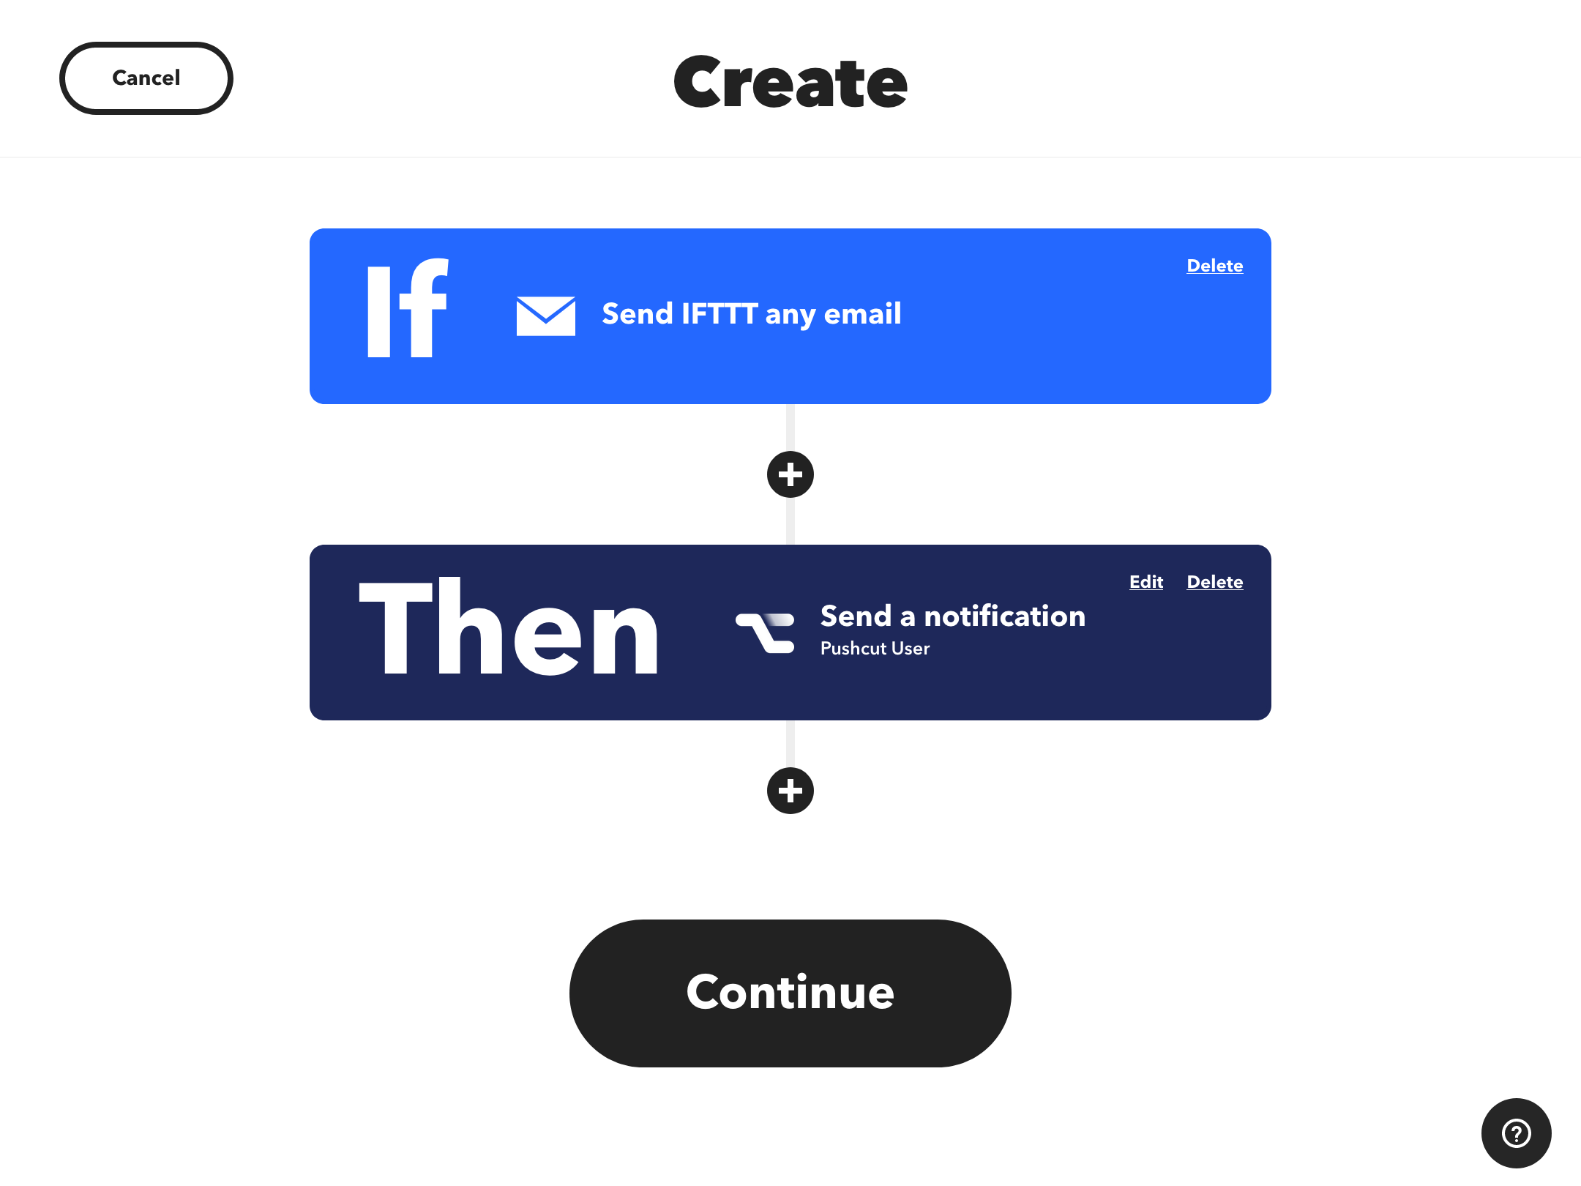
Data Transmission to Thingspeak: Establish a seamless connection to Thingspeak for efficient and centralized storage of runtime data, facilitating comprehensive analysis and historical tracking.
Innovative Notification System: Introduce an advanced notification system using IFTTT and React, triggering alerts when the runtime approaches or reaches the critical 300-hour threshold.
10

Slide 11
Result and Outcomes
Real-time monitoring ensures prompt detection of anomalies, reducing the risk of equipment damage. Integration with platted heat exchangers further refines temperature control. The innovative notification system contributes to proactive maintenance, averting potential issues. These advancements collectively aim to optimize engine testing processes, fostering increased efficiency, reduced downtime, and extended equipment lifespan, ultimately culminating in a more reliable and cost-effective testing environment.
11

Slide 12
CONCLUSION
In conclusion, the proposed "Engine Testing Cell Temperature Control System" stands as a transformative solution for optimizing engine testing processes. By replacing manual calculations with automated methods, leveraging real-time monitoring, and incorporating innovative notification systems, the project aims to enhance accuracy, reduce downtime, and prolong equipment lifespan.
12

Slide 13
Thanks!

